Slide 1
Geography Skills Vocab

Slide 2
1. Grid System
Pattern formed as the lines of latitude and longitude cross one another. Used to determine location on the earth.

Slide 3
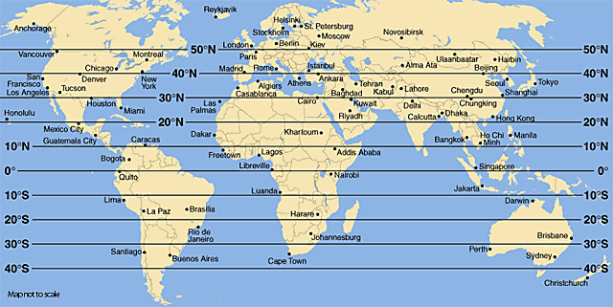
2. Latitude
Lines that run east & west on the earth. Used to show distance north & south of the equator.

Slide 4
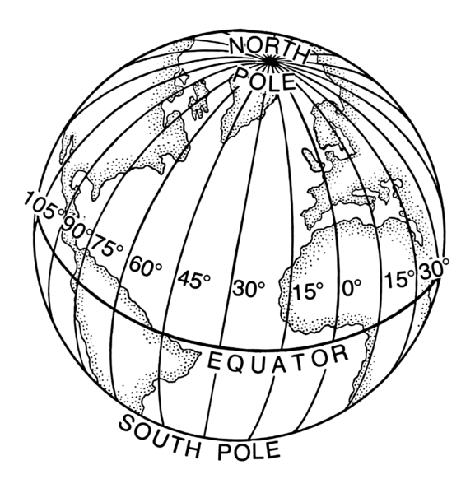
3. Longitude
Lines that run north & south on the earth. Used to show distance east & west of the Prime Meridian.

Slide 5
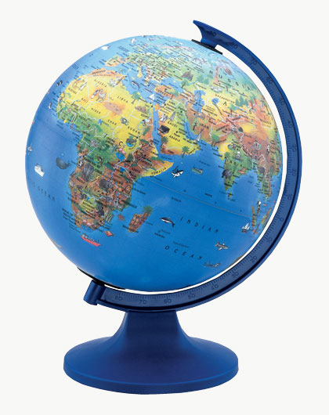
4. Globe
A round scale model of the earth.

Slide 6
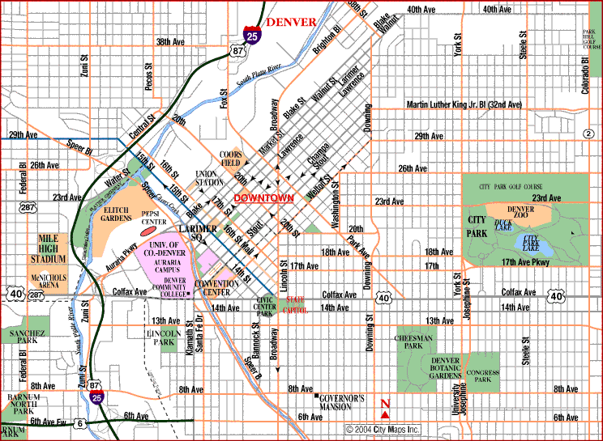
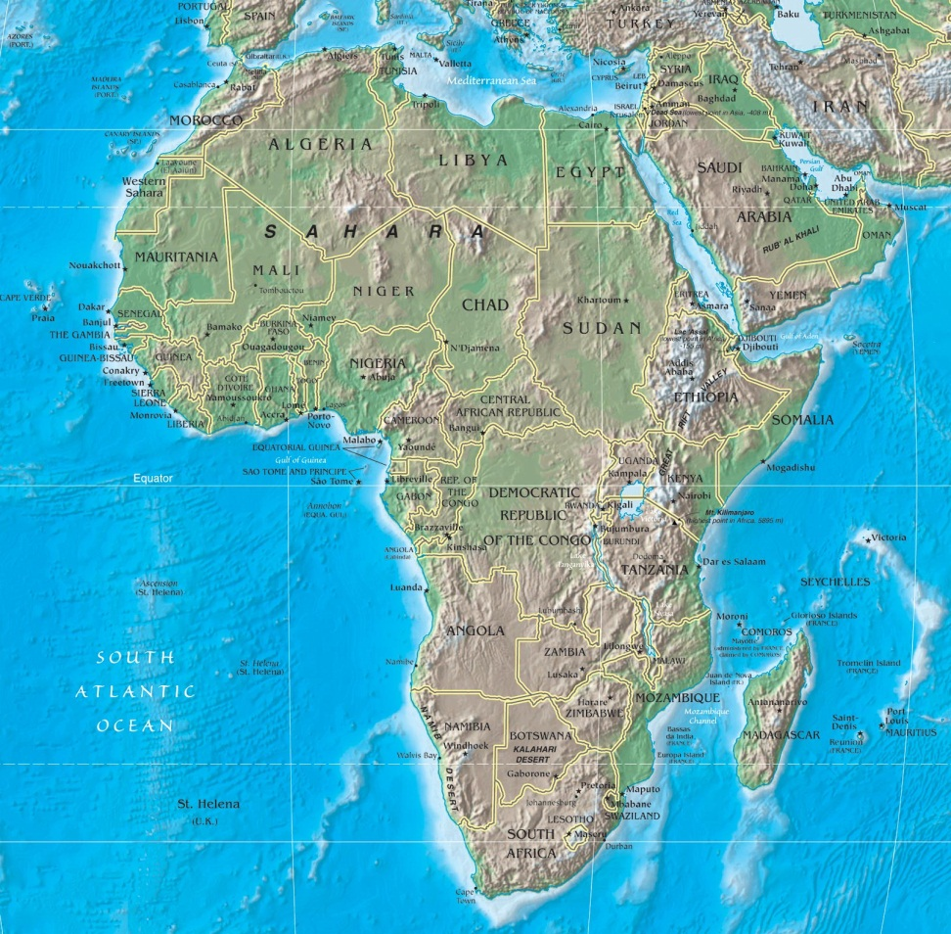
5. Map
A symbolic representation of all or part of the planet.

Slide 7
6. Cartographer
Mapmaker

Slide 8
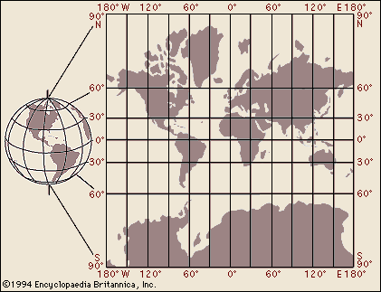
7. Map Projection
Projection of the round earth on a flat surface.

Slide 9
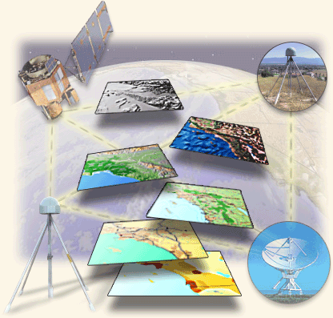
8. Geographic Information Systems
Used by cartographers. Computer tools for processing and organizing details and satellite images with other pieces of information.

Slide 10
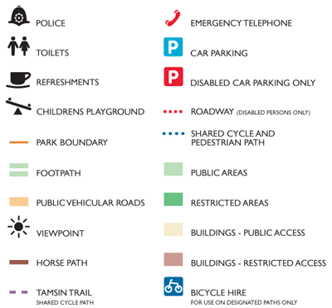
9. Key
A list that explains what the symbols on a map are used for.

Slide 11
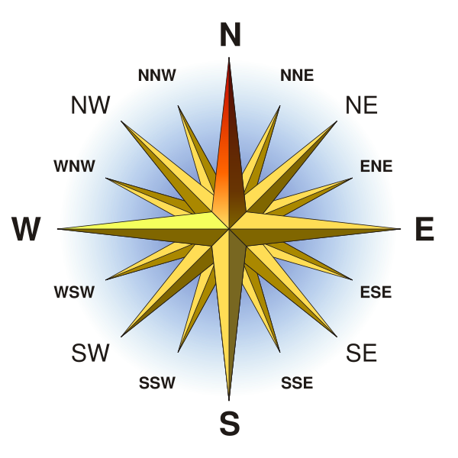
10. Compass Rose
A marker that indicates direction.

Slide 12
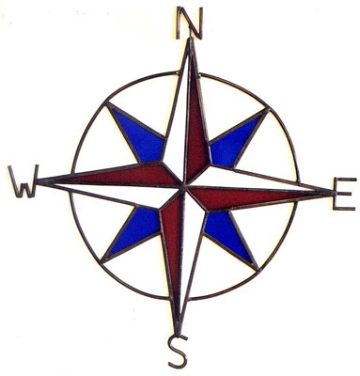
11. Cardinal Directions
North, South, East, & West

Slide 13
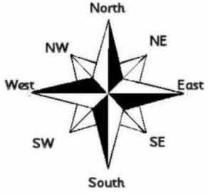
12. Intermediate Directions
Northeast,
Northwest,
Southeast,
Southwest

Slide 14
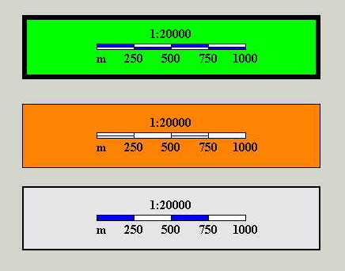
13. Scale Bar
Shows the relationship between map measurements and actual distances.

Slide 15
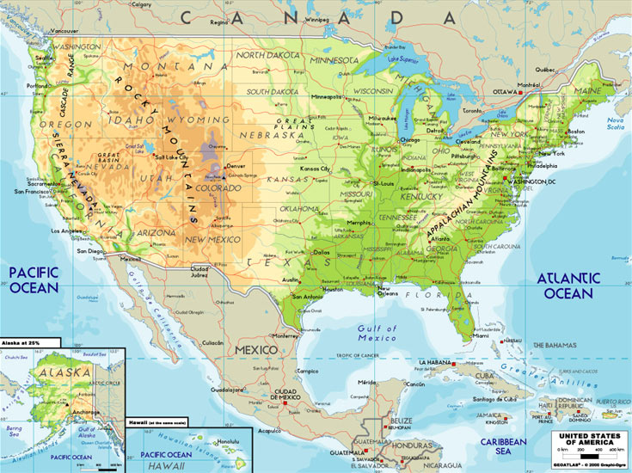
14. Physical Map
Shows the location and the shape of the earth’s physical features

Slide 16
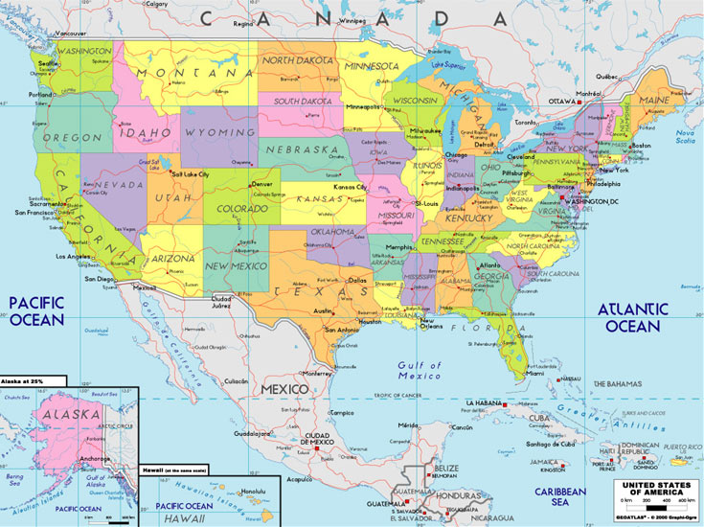
15. Political Map
Shows the boundaries between countries, and often other things such as cities.

Slide 17
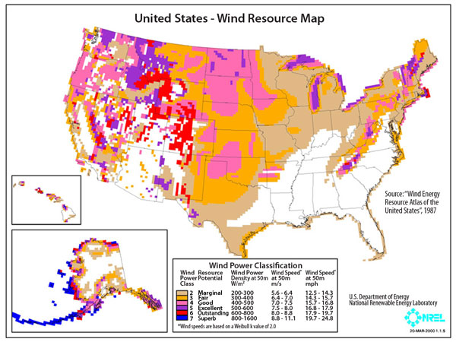
16. Special Purpose Map
A map that emphasizes a single idea or a particular kind of information about an area.

Slide 18
Remaining Vocab Words
17. Location
18. Small Scale Map
19. Large Scale Map
20. Absolute Location
21. Relative Location
22. General Purpose Map
23. Topography
24. Relief
25. Elevation
26. Contour Lines
27. Graphs
28. Line Graph
29. Bar Graph
30. Circle (Pie) Graph
31. Chart (or Table)
32. Diagram

