Slide 1
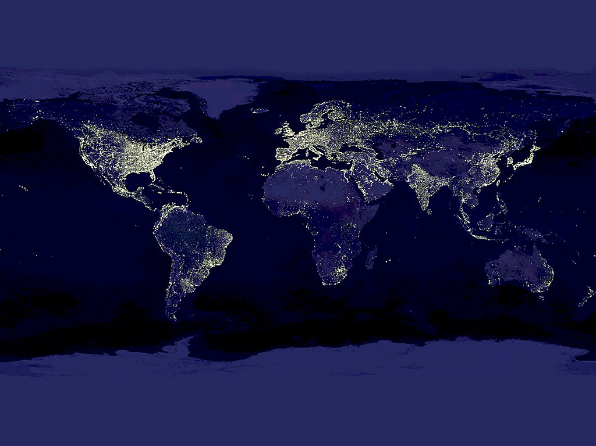
The Human World

Slide 2
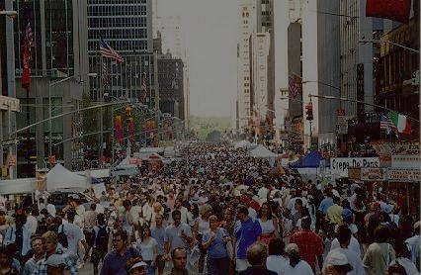
World Population

Slide 3
Population Growth
About 6.2 billion people live on the earth
They inhabit about 30% of the land
Growth Rates
Population is growing rapidly because birthrates have not declined as fast as death rates
Both are measured out of 1,000
Why do you think death rates have gone down in many areas of the world?
Challenges of Population Growth
What are some of the challenges we will continue to face as the population continues to grow?
Negative Population Growth
Hungary & Germany (for example)

Slide 4
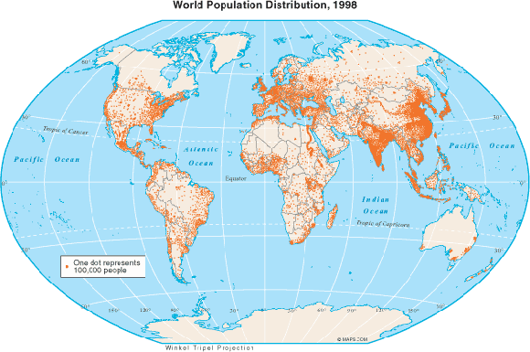
Population Distribution
Population Density
The average number of people living in one square mile (or kilometer)
Canada – 8 people per square mile
Bangladesh – 2,639 people per square mile

Slide 5
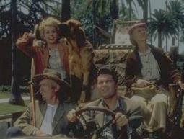
Population Distribution (Cont.)
Population Movement
Migration – movement of people from place to place
Many people are moving from rural areas to cities to look for opportunities (urbanization)

Slide 6
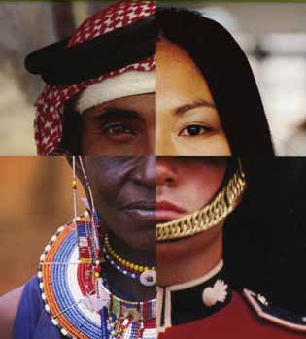
Global Cultures

Slide 7
Elements of Culture
Language
Variance within a language is called dialect
Languages are organized into language families
Example: Indo-European – English, Spanish, Russian, Hindi (spoken in India)

Slide 8
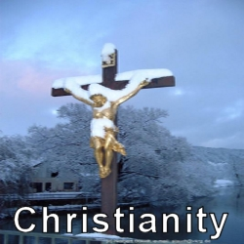
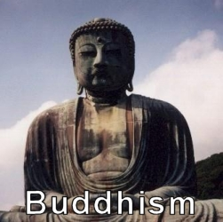
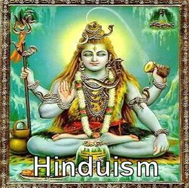
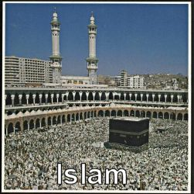
Elements of Culture (cont.)
Religion
Major World Religions Groups(5): Hinduism, Buddhism, Judaism, Christianity, & Islam
Struggle over conflicting ideas causes war

Slide 9
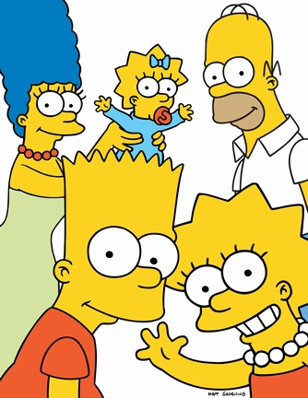
Elements of Culture (cont.)
Social Groups
Family is the most important group
Government
Many different types of these!
Economic Activities
Making a living
Culture Regions
Share common culture traits

Slide 10
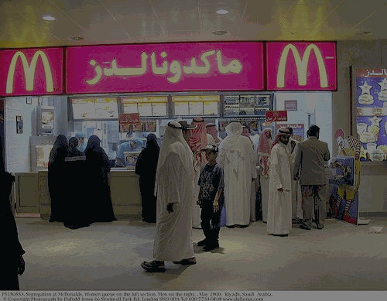
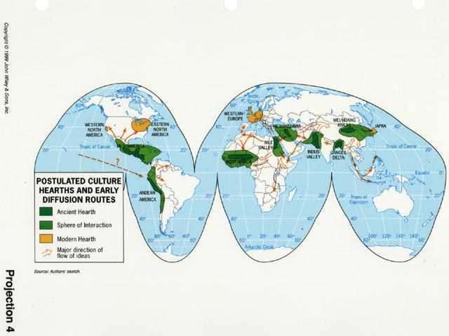
Culture Change
Cultural Diffusion – spreading new knowledge and skills from one culture to another
The Agricultural Revolution
Nomads – herders that moved locations
Culture Hearths – early centers of civilization whose ideas and practices spread to surrounding areas

Slide 11
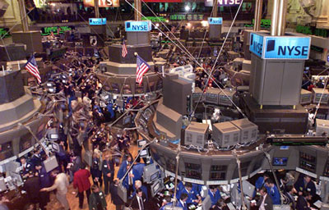
Political & Economic Systems

Slide 12
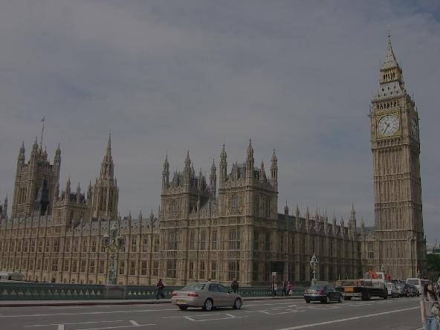
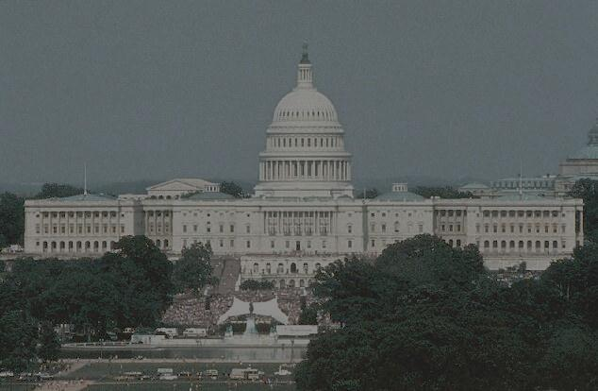
A. Levels of Government
Unitary System
Gives all key powers to the national or central government
United Kingdom & France
Federal System
Divides the power between national & state governments
United States

Slide 13
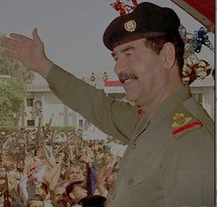
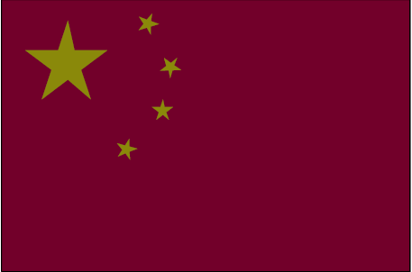
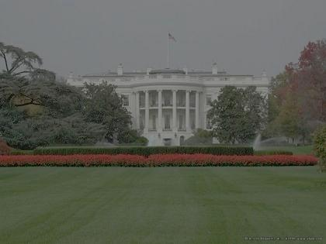
Types of Government
Autocracy
Power belongs to a single individual
Former Iraq
Oligarchy
A small group holds power
China
Democracy
Leaders rule with the consent of its citizens
United States

Slide 14
Economic Systems
Traditional Economy
Habit & customs determine the rules for economic activity
People are not free to have what they want, only what their elders say
Market Economy
Individuals & private groups make decisions about what to produce
Based on free enterprise – private individuals may own property or businesses
Also known as capitalism
No one has a true form of this – we have what is called a mixed economy (government helps to regulate)

Slide 15
Economic Systems (cont.)
Command Economy
Government owns or directs production & distribution of goods
Socialism & Communism
A command economy is called one of these two terms, depending on how much government is involved (communism is more strict)

Slide 16
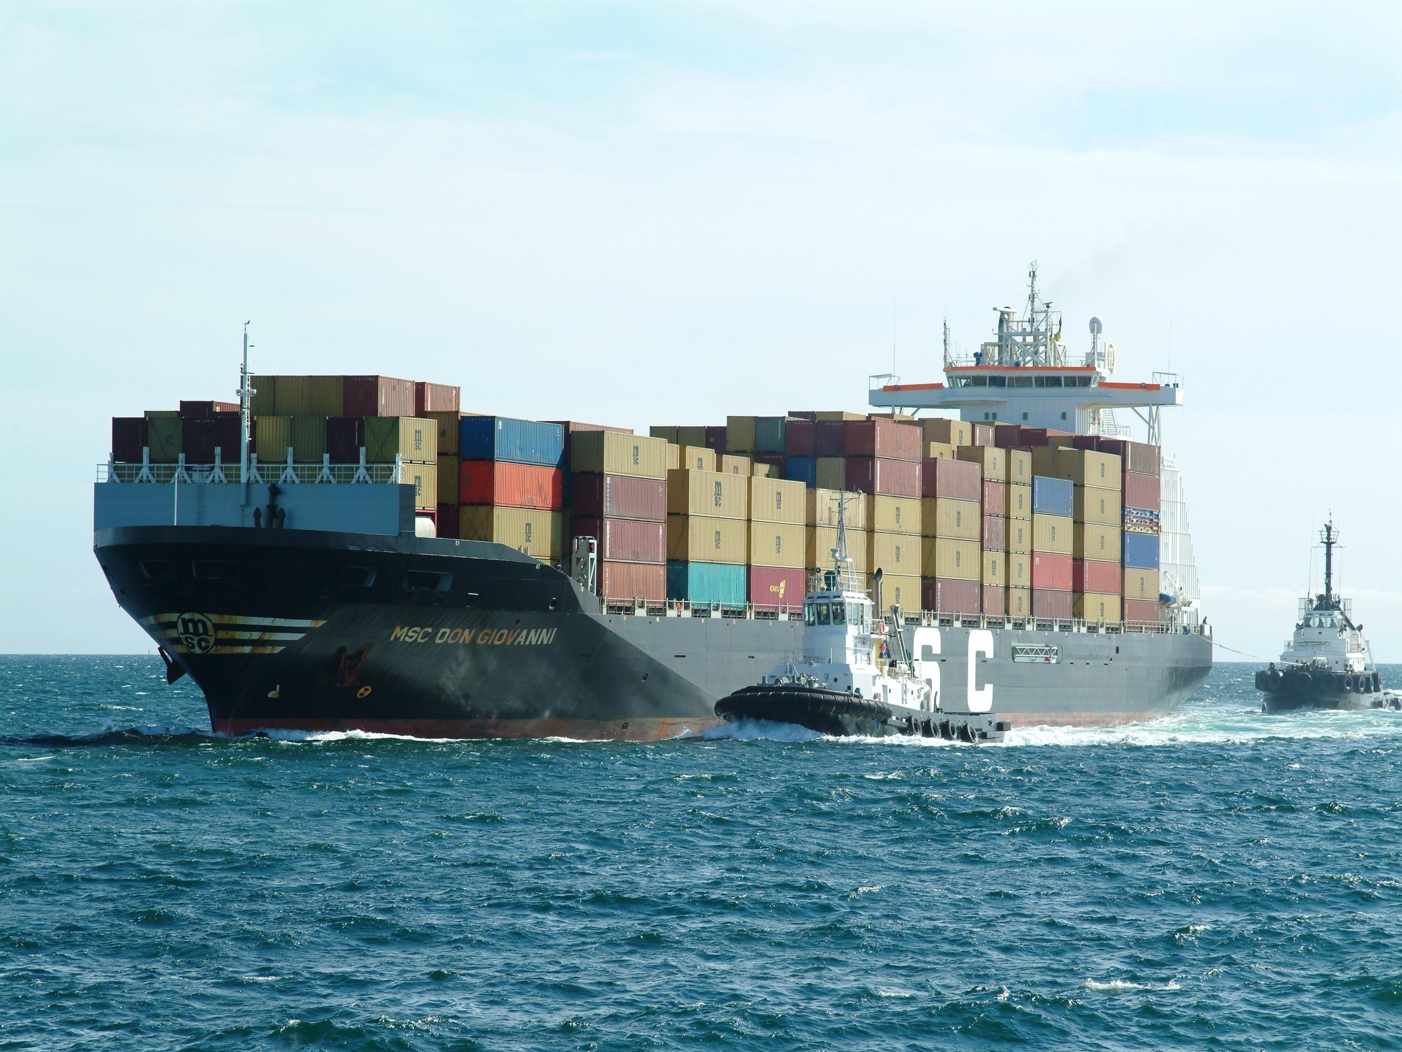
IV. Section IV
Resources, Trade, and the Environment

Slide 17
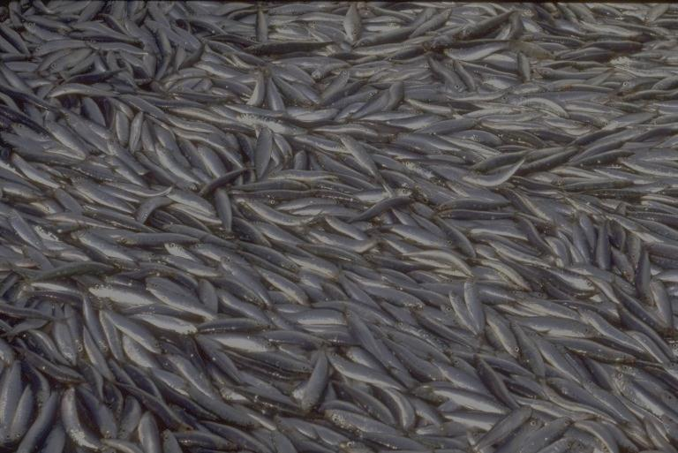
Resources
Natural Resources
Two types – renewable & nonrenewable
LEAVE ROOM IN YOUR NOTES TO MAKE A LIST OF TEN OF EACH!

Slide 18
Economic Development
Most natural resources are not evenly distributed
This uneven distribution effect the economy
Levels of development (2)
Developed countries – have much technology & manufacturing – U.S.
Developing countries – working towards more technology and manufacturing (mainly some countries in Africa, Asia, and Latin America)

Slide 19
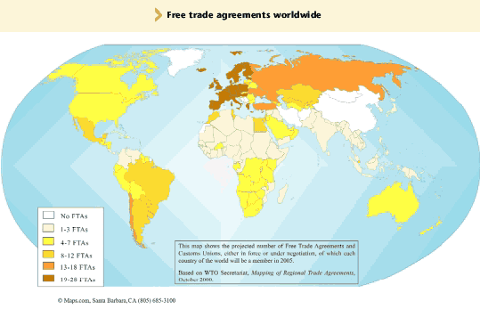
World Trade
Barriers to trade
Taxes or tariffs
Free Trade
Established to increase the import & export of goods between some countries

Slide 20
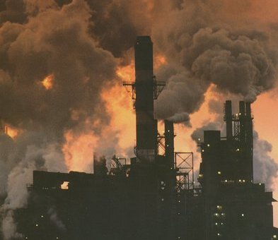
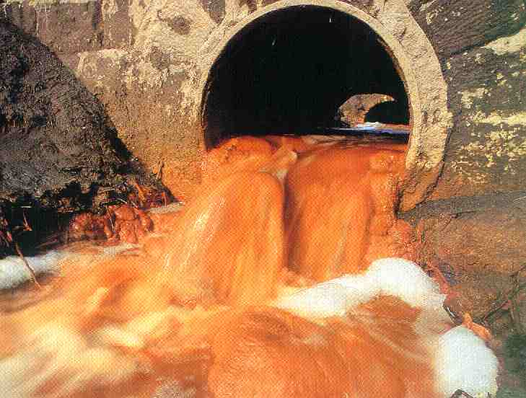
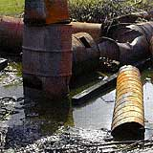
People & Their Environment
Pollution – 3 Types
Water, Land, and Air
Make a chart in your notes w/the 3 types of pollution and under each list at least 3 examples

